Slide 1
Web Foundations
Code Value boot camp

Slide 2
Course Content
Web Development
How the web works
HTML Fundamentals

Slide 3

About Me
Yair Oval
Web & Cloud Architect
25+ years of experience
Extensive work with startups
Dog lover (especially my own)

Slide 4
Course Goals
By the end of training you should be able to:
Build HTML pages
Style it using modern CSS
Make it responsive across devices
Use Browser DevTools to inspect, debug and improve code

Slide 5
Web Development

Slide 6
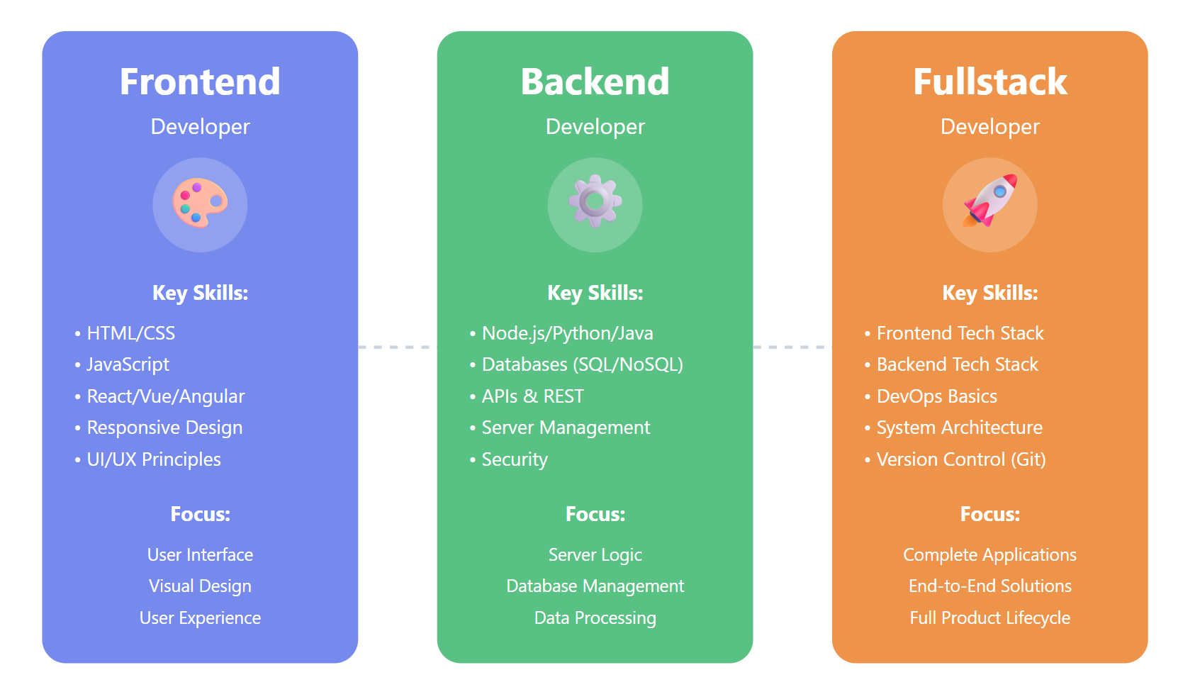
Web development

Slide 7
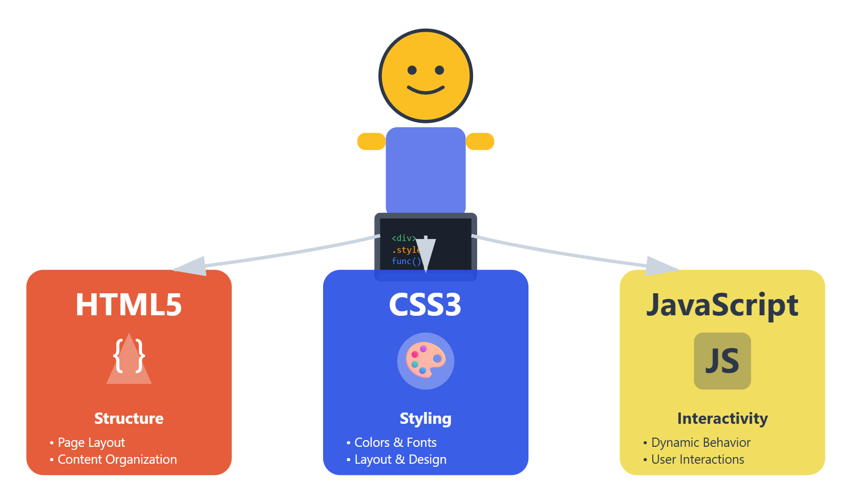
Frontend Developers

Slide 8
Frontend Frameworks
Frontend frameworks help developers build interactive, fast, and scalable user interfaces for the web.
Why Use Frontend Frameworks?
Build reusable components
Create dynamic, single-page applications (SPAs)
Improve performance and user experience
Easier to maintain large applications

Slide 9



Popular Frontend Frameworks

Slide 10
How the web works

Slide 11
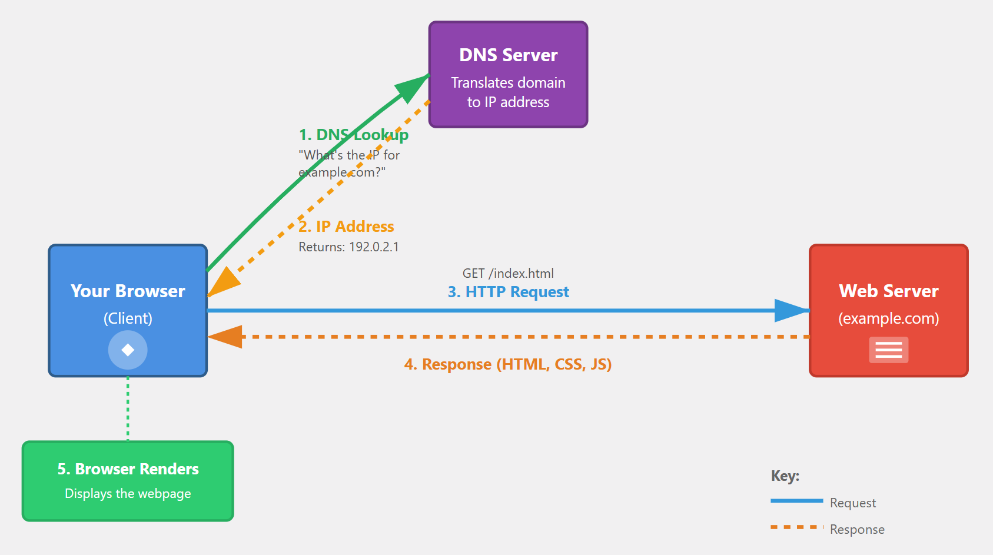
How the Web Works

Slide 12
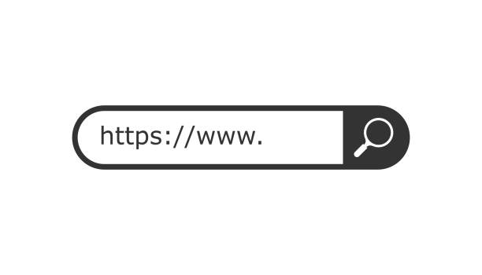
What is HTTP
HTTP - Hypertext Transfer Protocol
Set of rules that lets browsers and servers talk to each other on the web
HTTPS (HTTP Secure) is the secure version of HTTP

Slide 13
How HTTP Works
1. Client Makes a Request
You type a URL or click a link in your browser
The browser (client) sends an HTTP request to a server
Request includes:
Method (GET, POST, PUT, DELETE)
URL/path
Headers (metadata like cookies, content type)

Slide 14
How HTTP Works
2. Server Processes the Request
The server receives the request
It may:
Fetch data from a database
Run application logic
Read a file

Slide 15
How HTTP Works
3. Server Sends a Response
The server replies with an HTTP response
Response includes:
Status code (200 OK, 404 Not Found, 500 Error)
Headers
Body (HTML, JSON, images, etc.)

Slide 16
How HTTP Works
4. Browser Renders the Result
The browser receives the response
It renders the content (webpage, data, image)
Additional requests may be made for CSS, JS, images

Slide 17
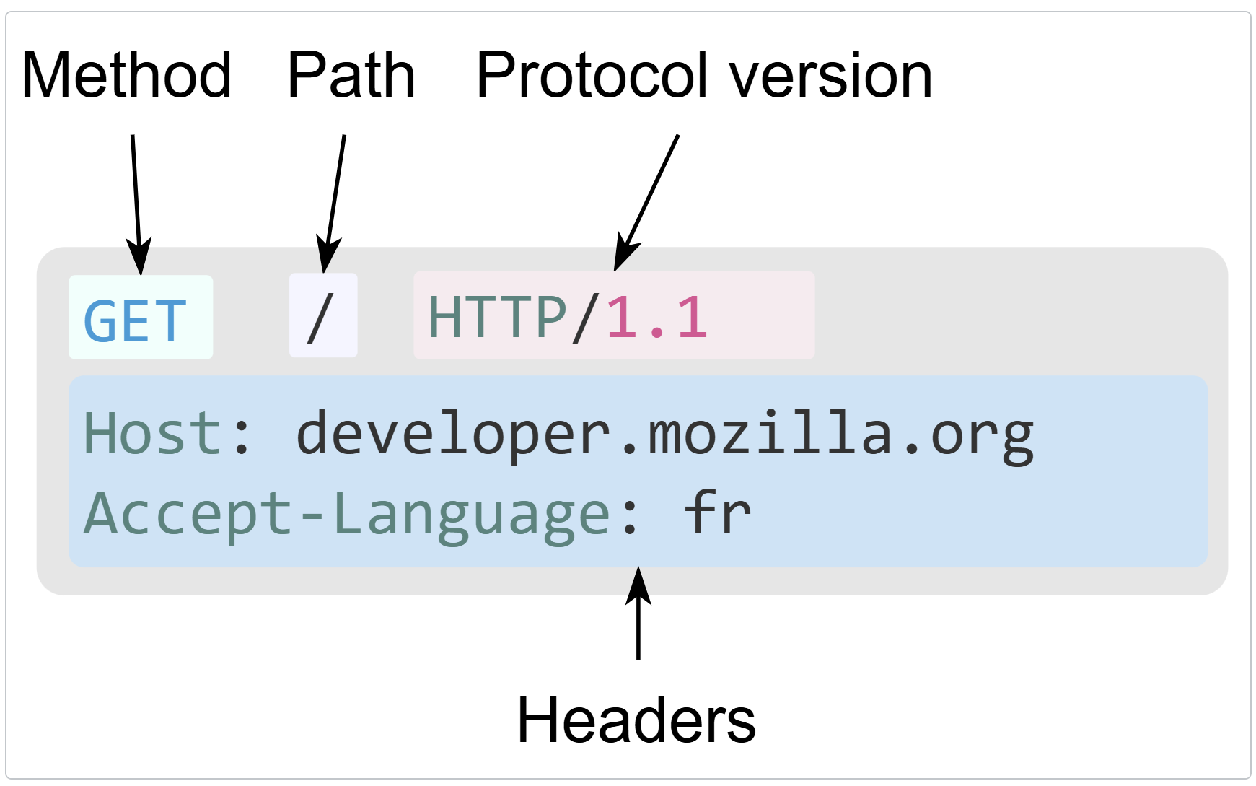
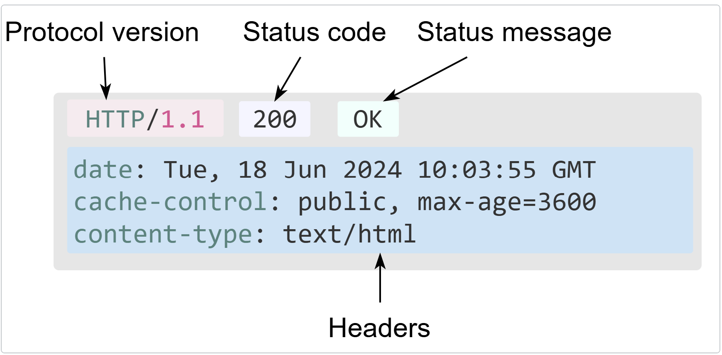
HTTP Message
Request
Response

Slide 18
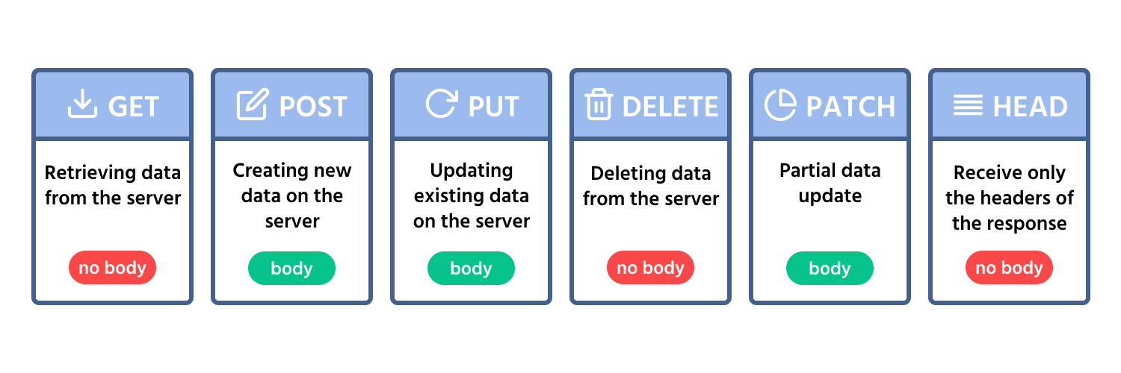
HTTP methods
Define what action the client wants the server to perform on a resource.

Slide 19
Demo
How the web works

Slide 20
HTML Fundamentals

Slide 21
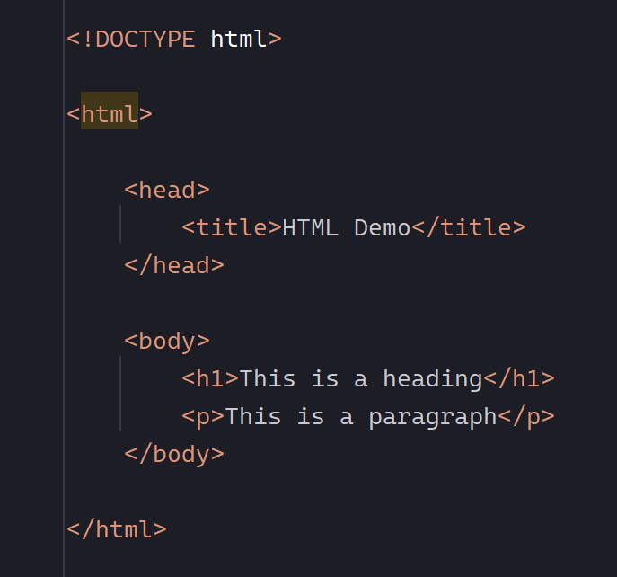
What is HTML
HTML = HyperText Markup Language
Defines the structure and content of a webpage
Uses tags to describe elements like:
headings, paragraphs, links, images, forms
Browsers read HTML and render it visually

Slide 22
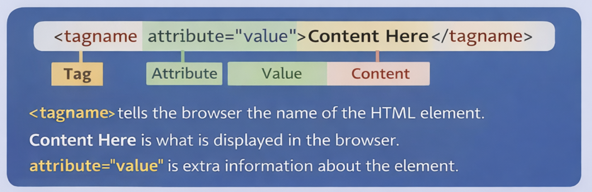
HTML Tags - Syntax
Tags are the building blocks of HTML
Example: <a href="https://www.google.com">go to google</a>

Slide 23
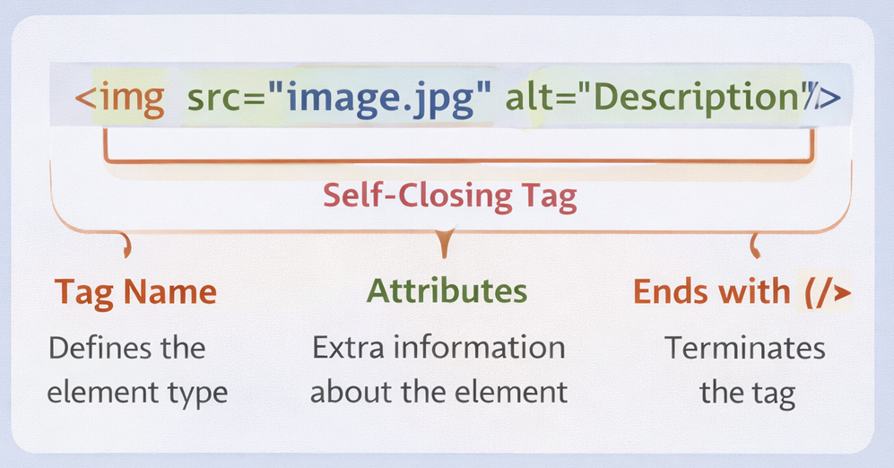
HTML Tags - Self-closing
Self-closing tags do not have separate opening and closing tags.
They end with /> and don’t contain content.

Slide 24
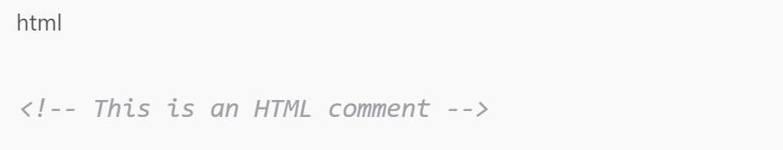
HTML Comments
They are not displayed on the page
Explain sections of code
Temporarily disable HTML elements
Leave notes for other developers

Slide 25
Editors
Visual Studio Code (VS Code) ⭐ Most Popular
Free and open-source by Microsoft
Extensive extension marketplace
WebStorm
Full-featured IDE by JetBrains
Advanced JavaScript/TypeScript support
Many more…

Slide 26
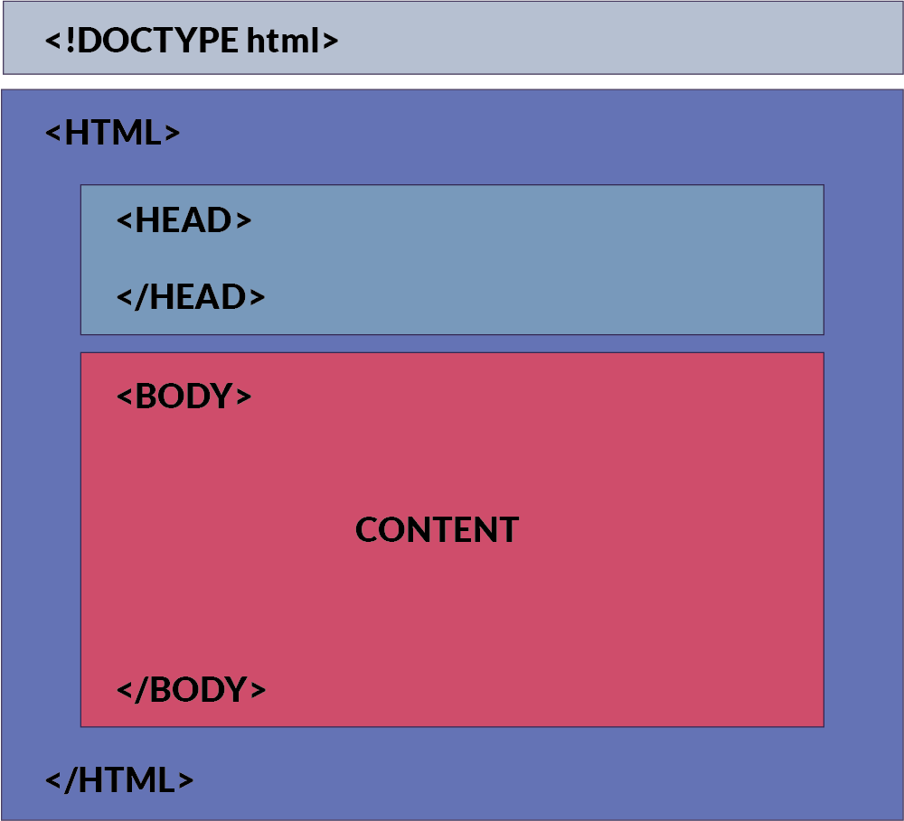
HTML document structure
<!DOCTYPE> – document type declaration
<html> – root element
<head> – metadata & resources
<body> – visible page content
Semantic elements

Slide 27

Web Browser & HTML
HTML is parsed by the browser
Browser converts HTML into the DOM (Document Object Model)
CSS & JavaScript are applied
Browser renders layout, styles, and interactivity

Slide 28
HTML Tags

Slide 29
Headings hierarchy
<h1>–<h6> define content hierarchy
Use one <h1> per page
Don’t skip heading levels
Headings describe structure, not style
Improves accessibility & SEO (Search Engine Optimization)

Slide 30
Paragraphs
Separate blocks of text into distinct paragraphs
Each <p> tag defines a separate paragraph block
The browser automatically adds spacing between paragraphs to enhance readability and maintain visual consistency.

Slide 31
Text formatting tags
HTML provides several text formatting tags:
The <strong> and <em> tags are used to emphasize text.
The <u> tag are used to underline text.
The <s> tag strikes through text.

Slide 32
Working with Links
Enable users to navigate between web pages, resources, and various forms of communication.
Types of URLs:
Absolute URLs "https://www.example.com"
Telephone URLs "tel:phone-number"
Email URLs "mailto:email-address"

Slide 33
Using Buttons
The <button> tag creates clickable buttons on web pages.
Types of buttons:
Standard - general purpose
Submit - submit form data
Reset - reset form fields

Slide 34
Working with Images
The <img> tag creates an image and requires at least two attributes:
src - the image file location
alt - alternative text for accessibility or when the image fails to load

Slide 35
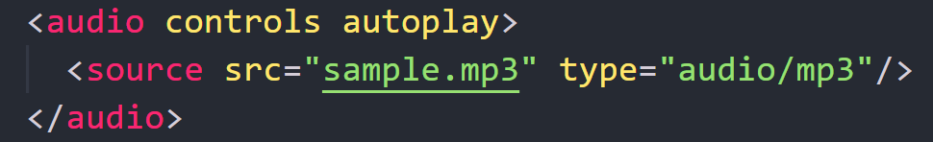
Embedding Audio Files
The <audio> tag displays an audio player inside the browser.
Useful Audio Attributes
controls: shows play, pause, volume, etc;
autoplay: starts playing automatically;
loop: repeats the audio continuously

Slide 36
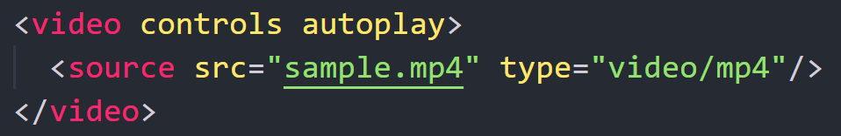
Embedding Video Files
The <video> tag embeds video content into an HTML document.
Useful Video Attributes
controls: shows play, pause, volume, etc;
autoplay: starts playing automatically;
loop: repeats the audio continuously

Slide 37
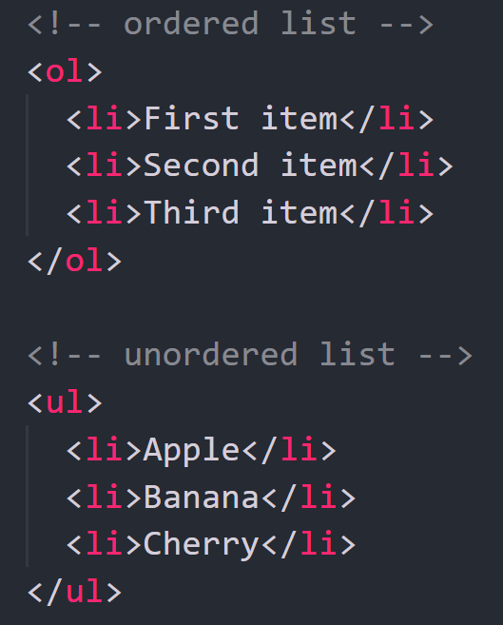
Organizing Lists
Lists can be created using two main tags:
<ul> unordered list with bullet points or other markers
<ol> ordered list with a specific order or ranking

Slide 38
HTML Tables

Slide 39
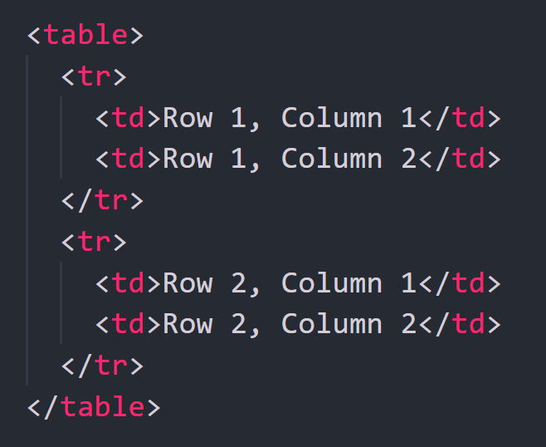
HTML Tables
Tables in HTML Used to display data in rows and columns.
Use the <table> tag to create a table.
Rows are defined with <tr>
Cells with <td>

Slide 40
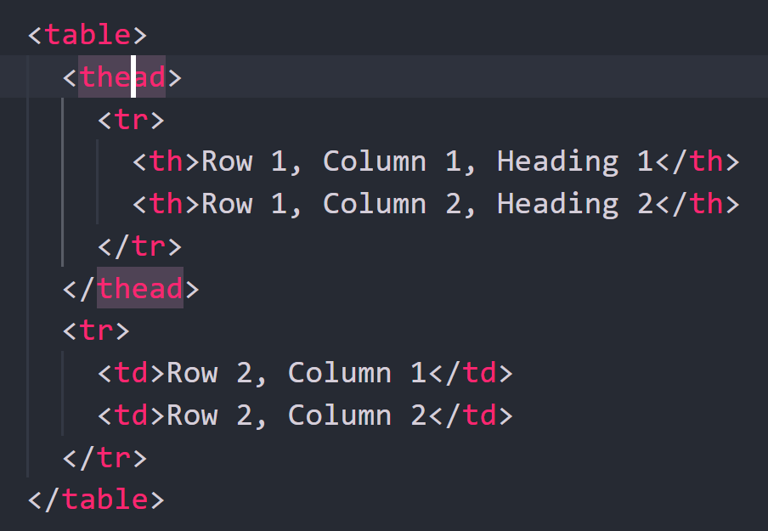
Table Headers
Use <th> for column or row headings.
Header cells usually go inside a <thead> section.
<thead> wraps header rows
<th> defines header cells

Slide 41
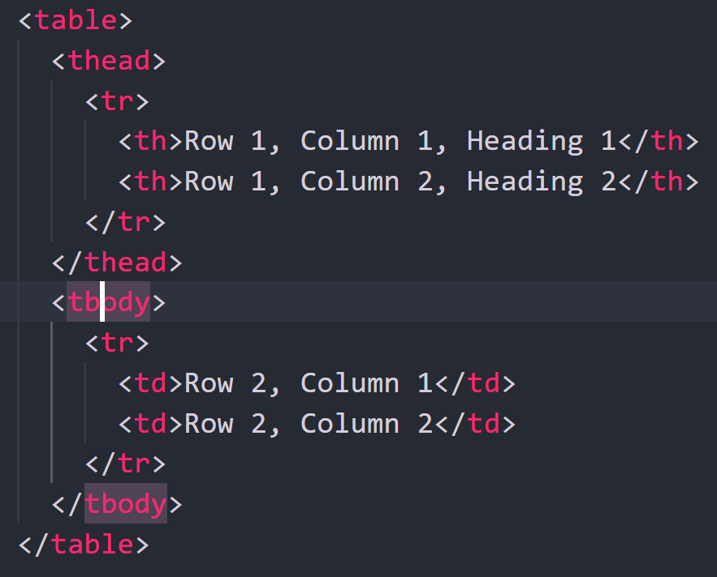
Table Body
The <tbody> section wraps the main table data (the regular rows).
Summarizing
<table>: main table container
<thead>: header row(s) with <th>
<tbody>: data rows with <td>
<tr>: a table row
<td>/<th>: data cell / header cell

Slide 42
HTML Forms

Slide 43
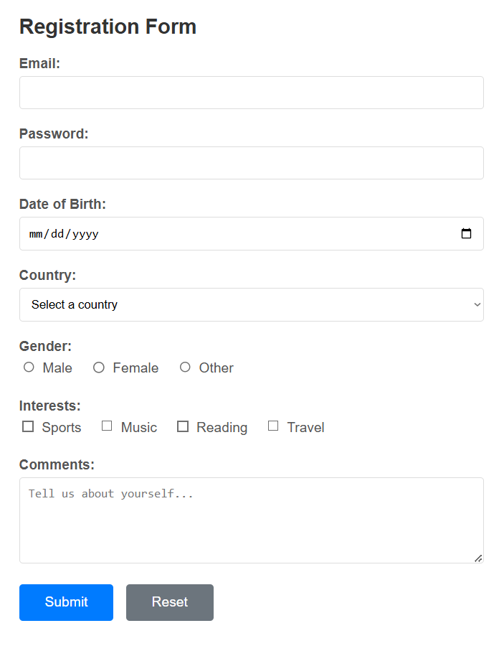
HTML Forms
Forms are the backbone of user interaction on web pages.
They allow users to share information, engage with content, and complete essential actions

Slide 44
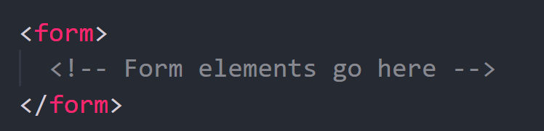
Building HTML Forms
An HTML form is used to collect user input.
The input is sent to a server for processing.
Forms are created using the <form> element.

Slide 45
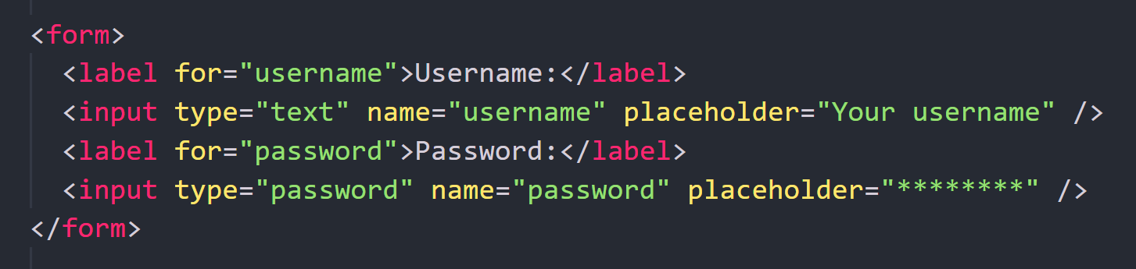
Form Elements
Forms contain labels and various input types (text, password, email, etc.).
Labels connect text to inputs and improve accessibility.

Slide 46
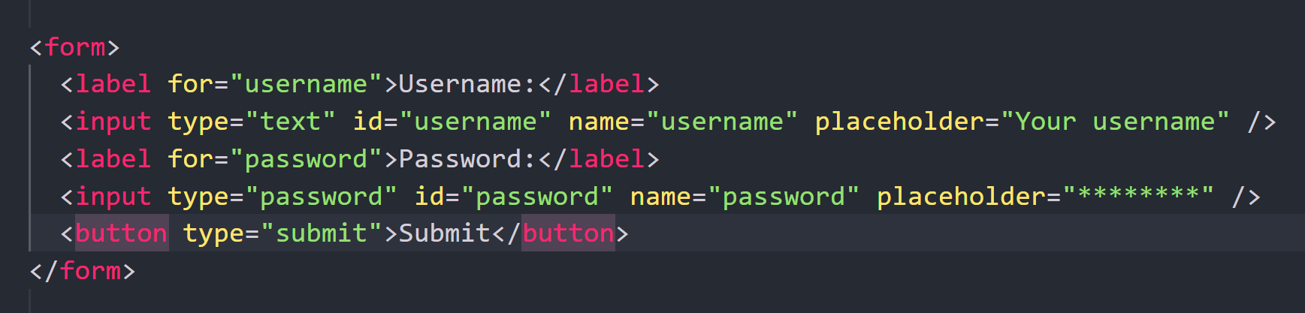
Form Submission
A form is submitted using a button with type="submit".

Slide 47
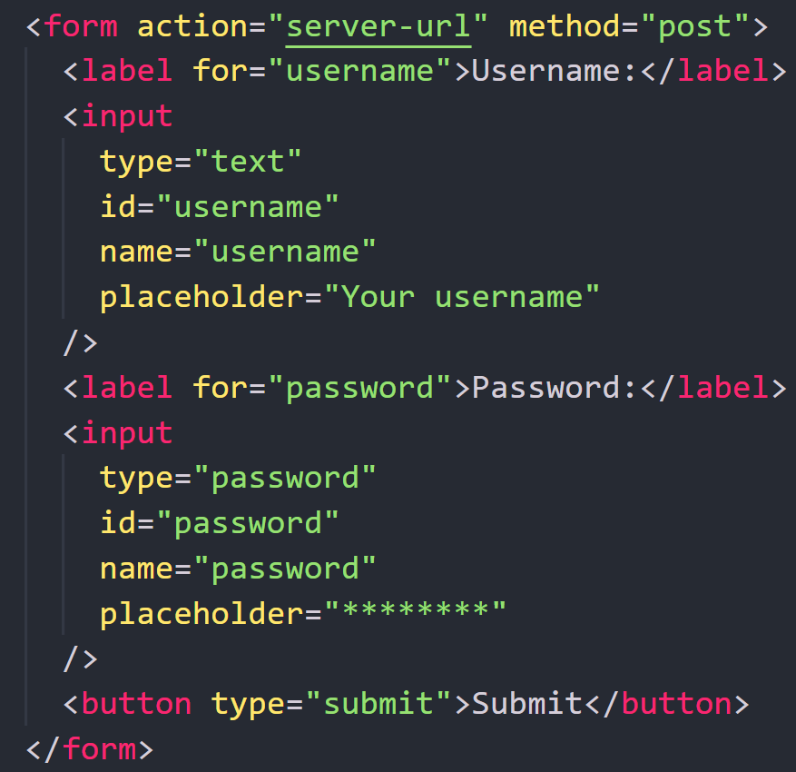
Form Attributes
action – where the data is sent
method – GET or POST

Slide 48
Common Form Elements
<input> – text, email, password, etc.
<label> – describes input fields
<textarea> – multi-line text input
<select> – dropdown list
<button> – submit/reset buttons

Slide 49
Common Input Attributes
Required
Prevents form submission if the field is empty.
Disabled
Makes the field non editable and non-interactive.
Readonly
Displays a value that users can copy but cannot change.
Name
Identifies the field when the form is submitted.
Placeholder
Shows hint text inside the field.
Value
Sets a default value in the field.

Slide 50
Common Input Types
Text Input
Designed for short textual data input, such as usernames, email addresses, or brief messages.

Slide 51
Common Input Types
Password Input
Used for password input, where characters are masked for security purposes.

Slide 52
Common Input Types
Number Input
Used for collecting numerical data from users. Provides a numeric keypad on mobile devices.

Slide 53
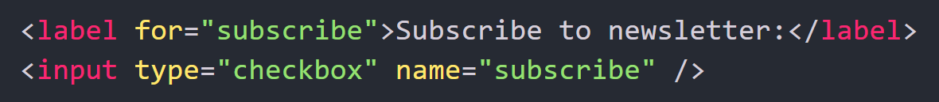
Common Input Types
Checkbox
Allows users to select one or more options from a list of choices.

Slide 54
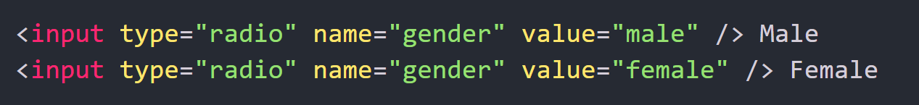
Common Input Types
Radio Button
Allows users to select one option from a list of mutually exclusive choices.

Slide 55
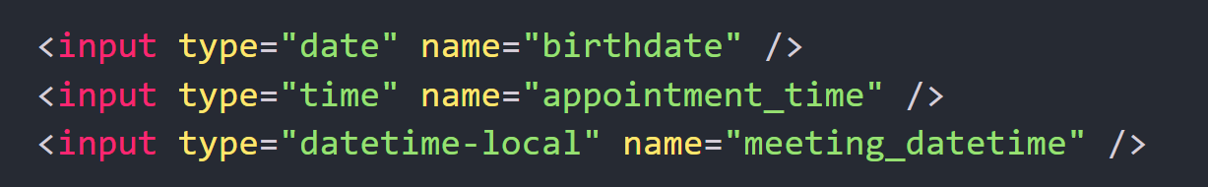
Common Input Types
Date Input, Time Input, and DateTime Input
Allows users to input dates, times, or both. Provides user-friendly interfaces for selecting dates and times.

Slide 56
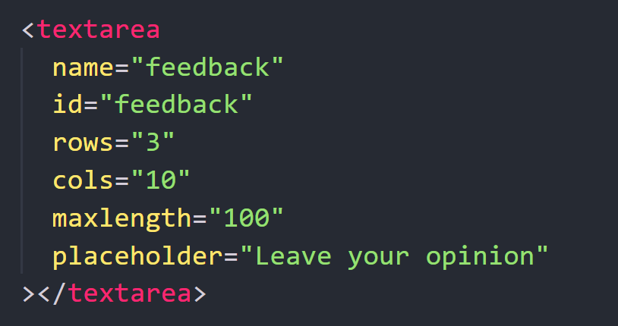
Working with the Textarea Element
The <textarea> element is a powerful tool for creating a multi-line text input field on a web page.
Attributes
rows and cols: determine the number of visible rows and columns of the text area
maxlength: specifies the maximum number of characters that can be entered

Slide 57
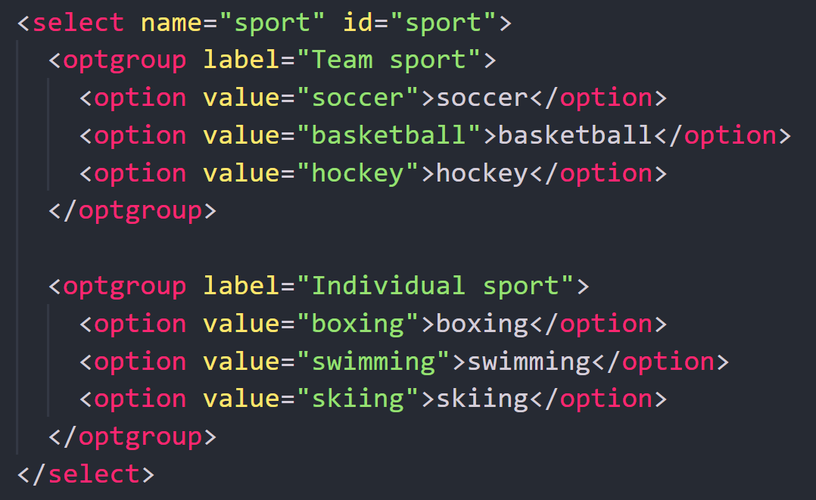
Using the Select Element for Dropdown
The <select> element is used to create a dropdown list of options for the user to choose from.
Attributes
size: the number of visible options in the dropdown list
multiple: if present, allows the user to select multiple options

Slide 58
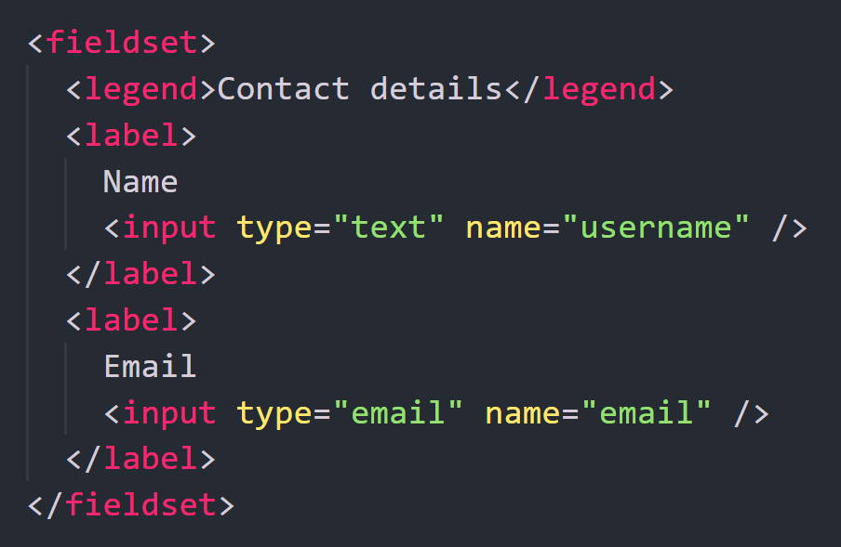
Grouping Form Elements
When form fields are related, grouping them helps users process information more easily.
Elements
<fieldset> groups related form controls
<legend> adds a title for that group

Slide 59
Thank You

